Slide 1
Secure Hardware-Based Public Cloud Storage
Bojan Suzic
Open Identity Summit 2013 September 10th, Kloster Banz
Secure Information Technology Center - Austria

Slide 2
Agenda
Motivation
Related Work
Citizen Card and CCE-Software
Implementation
Comparison with existing Solutions
Conclusion and Future Work

Slide 3
Agenda
Motivation
Related Work
Citizen Card and CCE-Software
Implementation
Comparison with existing Solutions
Conclusion and Future Work

Slide 4
Motivation
Storage in the public cloud

Slide 5
Motivation
Secure storage in the public cloud using a smart-card

Slide 6
Agenda
Motivation
Related Work
Citizen Card and CCE-Software
Implementation
Comparison with existing Solutions
Conclusion and Future Work

Slide 7
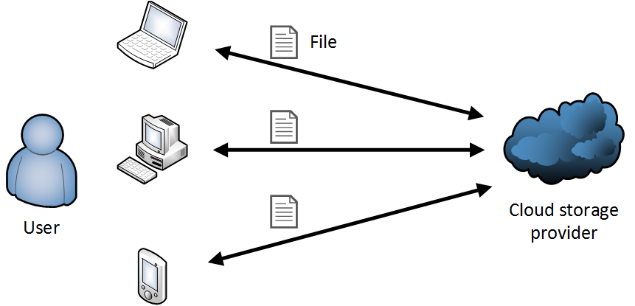
Related Work
Cloud Storage Services
DropBox
Google Drive
Microsoft SkyDrive
etc.
Cloud Storage Services (client based encryption)
TeamDrive
Wuala

Slide 8
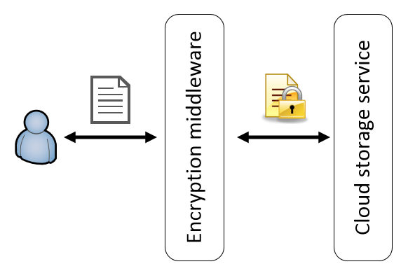
Related Work
Encryption Middleware
Middleware Layer performs encryption between Client and Cloud Storage Service
Support for diverse Cloud Storage Service Providers
BoxCryptor
Cloud Fogger
Viivo
etc.

Slide 9
Agenda
Motivation
Related Work
Citizen Card and CCE-Software
Implementation
Comparison with existing Solutions
Conclusion and Future Work

Slide 10
The Concept of Citizen Card
Citizen Card* technology-neutral
Smart-Card or Handy-Signatur
Citizen Card unifies…
eIdentification
Qualified eSignature
Data encryption
Central LDAP-Server
eMandates (Mandates/Powers)
eDelivery
* Locally known as Bürgerkarte

Slide 11
The Software CCE (Citizen Card Encrypted)
Platform-independent Open Source-Tool
Encryption and decryption based on Software and Hardware keys
Supports Austrian Citizen Card
S/MIME as Container-Format
Uses local file-system as a data storage

Slide 12
CCE Properties
Secure decryption unit
Decryption using Smart Card
Hybrid approach
Group based encryption
Encryption for several users and groups
Backup-key
Austrian PKI Infrastructure
LDAP Directory

Slide 13
Agenda
Motivation
Related Work
Citizen Card and CCE-Software
Implementation
Comparison with existing Solutions
Conclusion and Future Work

Slide 14
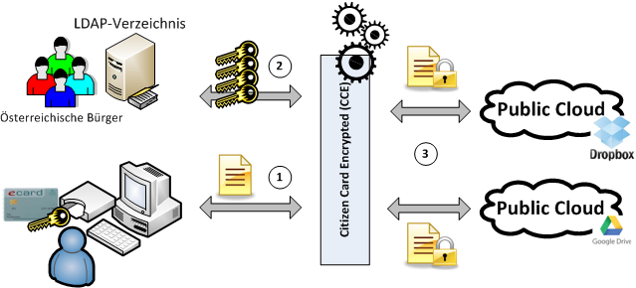
Implementation
LDAP directory
Austrian Citizens

Slide 15
Implementation
Inclusion of Cloud Storage Services
DropBox
Google Drive
Mapping between Cloud-Credentials and Smart Card
Logging in automatically
Connecting with File System
Synchronization of local folder with remote Service

Slide 16
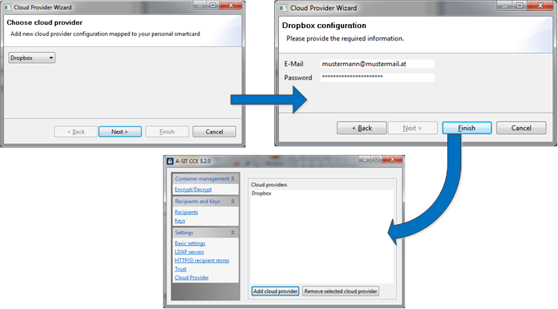
Screenshot - Configuration

Slide 17
Screenshots - Encryption

Slide 18
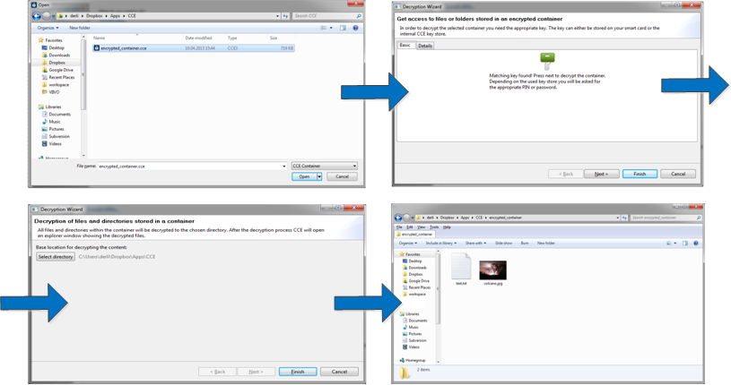
Screenshots - Decryption

Slide 19
Agenda
Motivation
Related Work
Citizen Card and CCE-Software
Implementation
Comparison with existing Solutions
Conclusion and Future Work

Slide 20
Evaluation - Advantages
Usage of external PKI Infrastructure
LDAP Directory enables encryption for arbitrary Austrian citizen
User-Management separated from Cloud Provider
Vendor Lock-In Prevention
Keys are managed by trusted external party, not CCE
Changing cloud provider easier

Slide 21
Evaluation - Advantages
Secure Hardware-based decryption
Private Key cannot be read
2-Factor Authentication
Open Source Implementation
Easy to extend
Cloud Provider, Container-Format, PKI, etc.

Slide 22
Evaluation - Disadvantages
Web Interface and Mobile version missing
Usage of Smart Cards on mobile phones
Storing private key securely
Two way sync with Cloud Storage
First encrypted locally, then uploaded
Smart card reader necessary
Reducing the systems to be used

Slide 23
Agenda
Motivation
Related Work
Citizen Card and CCE-Software
Implementation
Comparison with existing Solutions
Conclusion and Future Work

Slide 24
Conclusion and Future Work
Secure storage in the Public Cloud using Smart Cards
Supports DropBox and Google Drive
Uses Austrian PKI Infrastructure
Development of mobile versions for iOS and Android
Evaluation of Browser-Version

Slide 25
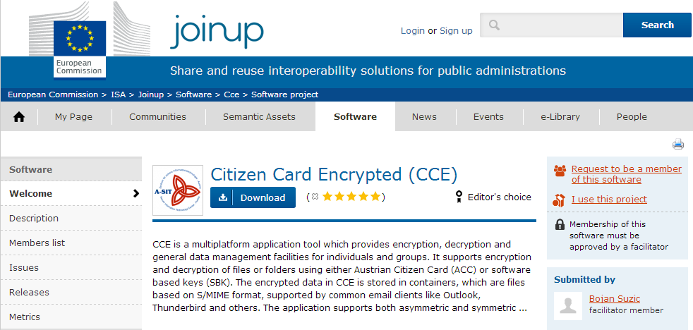
Conclusion and Future Work
Available on Joinup.EU Platform
EUPL Open-Source License
Collaboration

Slide 26
Thanks for your attention!
Questions?
○
Bojan Suzic bojan.suzic@iaik.tugraz.at
https://joinup.ec.europa.eu/software/cce/home

